Slide 1
The BUSINESS CASE for IPM in Schools or How IPM Can Make Money for Your School District Thomas A. Green, Ph.D. President, IPM Institute of North America Washington Coalition Meeting Federal Way, WA April 30, 2015

Slide 2
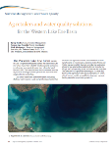
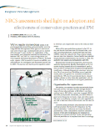
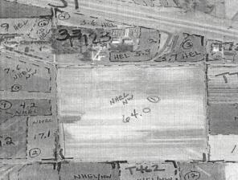
Leveraging marketplace power to improve health, environment and economics
Check Strip
Eighth International IPM Symposium
March 2015, Salt Lake City
BMP Strips

Slide 3
Customers choosing green
Market Drivers
Pesticides a
top concern
of 60%!
Source: http://www.contextmarketing.com/sources/feb28-2010/cm-ethicalfood-cover.pdf
Notes:
Tried new
“43% have purchased a brand that was new to them mainly because they saw that the company was producing it embraces socially responsible practices.”
Source: http://www.contextmarketing.com/sources/feb28-2010/cm-ethicalfood-cover.pdf
Stopped buying
“48% have stopped buying a brand because they learned the company producing it was acting in a way they consider to be socially irresponsible or unethical.”
Source: http://www.contextmarketing.com/sources/feb28-2010/cm-ethicalfood-cover.pdf
Recommend
“55% more likely to recommend ethically produced food brands and products.”
Source: http://www.contextmarketing.com/whitepaper-optimized.pdf
Believe healthier
“60% believe ethically produced food is healthier to eat.”
Source: http://www.contextmarketing.com/whitepaper-optimized.pdf
Will pay more
“68% willing to pay more for food produced to higher ethical standards.”
Source: http://www.contextmarketing.com/whitepaper-optimized.pdf
Would buy
“95% would buy more green products contingent on: price, increased availability, identifiable as green, incentive programs, donations to charities and trial offers.”
Source: https://www.deloitte.com/assets/Dcom-Lebanon/Local%20Assets/Documents/Consumer%20Business/DeloitteGreenShopperStudy_2009.pdf
MORE RESEARCH
58% of Millennials surveyed said they were willing to pay more for natural/organic products.
Source: http://www.alixpartners.com/en/MediaCenter/PressReleases/tabid/821/articleType/ArticleView/articleId/258/Rise-of-the-Millennials-and-Aging-of-the-Boomer-Generation-Will-Mean-Trouble-in-Aisle-5-for-Established-Food-Brands-and-Traditional-Grocery-Stores.aspx#sthash.I1s6BcIh.5jW22Xoo.dpbs
A 2013 survey of 1300 chefs by the National Restaurant Association says that Environmental Sustainability will be the hottest menu trend 10 years from now. (Currently ranked # 3 behind local meat/seafood and local produce).
Source: http://www.takepart.com/article/2013/12/12/top-food-trends-2014
In 2011 53% of US consumers planned to buy green grocery products, compared with:
45% Household products
37% Personal care
33% Packaged food/beverages
27% Energy
22% Retail
22% Technology
15% Quick service restaurants
12% Automotive
8% Hospitality
8% Mobile provider services
Source: http://www.environmentalleader.com/charts/consumer-intent-to-buy-green-products/

Slide 4
Green building accounted for 20% of all new US commercial construction in 2013. - National Mortgage Professional Magazine, Oct. 30, 2014. We need to be prepared for a future where the expectation is green!
Urban/Community Environments?
Harnessing Marketplace Power to Improve Health, Environment and Economics
Notes:
Tom

Slide 5
Business Case?
Fewer staff and student absences
Better student performance
Fewer pests, fewer costly complaints
Greater staff satisfaction
Lower liability
Food safety
Fire safety
Energy, water conservation
Better buildings
Direct pest management costs
Indirect costs

Slide 6
A Look at the BIG Picture
Harnessing Marketplace Power to Improve Health, Environment and Economics
Notes:
Tom

Slide 7
IPM is a Continuum!
I do IPM!
I do more IPM!
Harnessing Marketplace Power to Improve Health, Environment and Economics
Notes:
Tom

Slide 8
I’m the real IPM baby!
Ultimate IPM
Harnessing Marketplace Power to Improve Health, Environment and Economics
Notes:
Tom

Slide 9
Business Case?

Slide 10
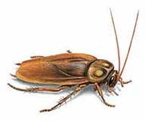
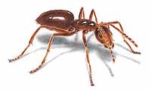
Common Pests for Schools
head lice
bees/wasps
rodents
ants
flies
cockroaches
mosquitoes
termites
birds
weeds

Slide 11
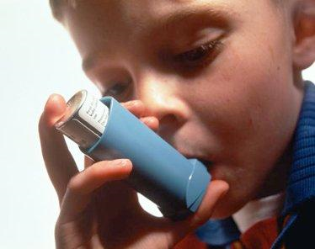
IPM and Asthma
Asthma is the number one cause of school absences
More than 12.8 million school days lost
every year!
Affects 6% of school children nationally.
Up to 28% in urban centers.
Treating children costs $3.2 billion per year!
Harnessing Marketplace Power to Improve Health, Environment and Economics
Notes:
Tom

Slide 12
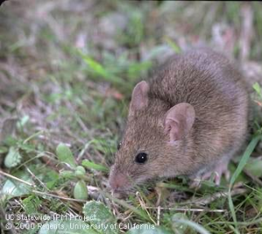
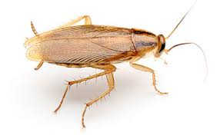
IPM and Asthma
Asthma symptoms can result from and be triggered by exposure to cockroaches, rodents, dust mites, cleaning products, aerosols including pesticides.
Mouse allergen levels higher in schools than in homes; students in classrooms with higher mouse allergens were absent more.
Sheehan et al. 2009. Ann. Allergy Asthma Immunol.
Cockroach allergen levels in school highly significantly correlated with student asthma prevalence.
- Amr et al. 2003. Ann. Allergy Asthma Immunol.
Harnessing Marketplace Power to Improve Health, Environment and Economics
Notes:
Tom

Slide 13
Asthma Allergens?
What school nurses believe
Dust 78.4%
Mold 61.0%
Cleaners 34.1%
School supplies 28%
Bus fumes 26.3%
Construction 23.7%
Pets 19.7%
Paint 12.6%
Latex 4.3%
Drinking water 1.9%
Other 17.7%
- Klelb et al. 2007. J. School Nursing
Allergens researchers found
in Boston schools
Mouse high
Cat moderate
Dog low
Dust mite zero
Cockroach zero
Sheehan et al. 2009. Ann. Allergy Asthma Immunol.
Review of studies of settled dust in schools showed many report at least one location where concentrations of cat, dog, dust mite and cockroach allergens exceeded risk levels.
- Tranter. 2005. Clin. Exp. Allergy
Harnessing Marketplace Power to Improve Health, Environment and Economics
Notes:
Tom

Slide 14
Attendance => Performance!
“student attendance is a statistically significant predictor of performance” on standardized tests.
- Musser. 2011. Taking Attendance Seriously: How School Absences Undermine Student and School Performance in NYC.
Long-term impacts!
Chronic absence in kindergarten strongly associated with lower reading and math performance in fifth grade for poor children
Chang and Romero. 2008. Present, Engaged and Accounted Ffor: The Critical Importance of Addressing Chronic Absences in the Early Grades.
Attendance = $$ lost from budgets
% of enrolled students who attend school each day is often used for allocating funding. Los Angeles Unified estimated loss of $32/day (2011). May only apply to unexcused absences.
Harnessing Marketplace Power to Improve Health, Environment and Economics
Notes:
Tom

Slide 15
Business Case?
Fewer staff and student absences
Better student performance
Fewer pests, fewer costly pest complaints
Greater staff satisfaction
Lower liability
Food safety
Fire safety
Energy, water conservation
Better buildings
Direct pest management costs
Indirect costs

Slide 16
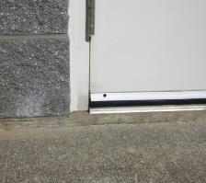
IPM Reduces Pest Complaints!
School systems: 90% reduction in pesticide use; 85% reduction in pest complaints.
Costs: no more than conventional
Gouge et al. 2006. Amer. Entomol.
Public buildings: 93% reduction in pesticide use; 89% reduction in pest complaints; 55 buildings over 11 years.
Greene and Breisch. 2002. J. Econ. Entomol.
Effective door sweeps alone can cut pest complaints by 65%.
Harnessing Marketplace Power to Improve Health, Environment and Economics
Notes:
Tom

Slide 17
How?
Harnessing Marketplace Power to Improve Health, Environment and Economics
Notes:
Tom

Slide 18
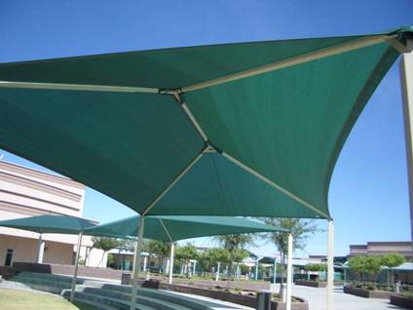
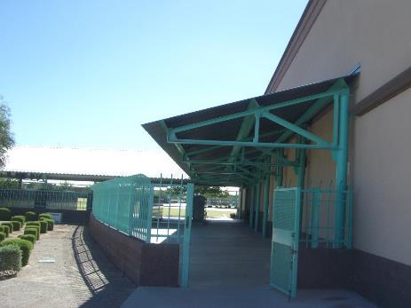
An Ounce of Prevention…
No roosting site here
Bird Heaven!
I do more IPM!
The school on the right spent $10,000 shortly after construction on bird netting. Netting was ineffective due to corrugations in the metal roofing. Birds were using the netting to support nests!
I do IPM!
Harnessing Marketplace Power to Improve Health, Environment and Economics
Notes:
Tom

Slide 19
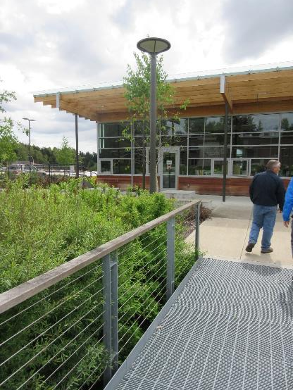
An Ounce of Prevention…
I do IPM!
I do more IPM!
Harnessing Marketplace Power to Improve Health, Environment and Economics
Notes:
Tom

Slide 20
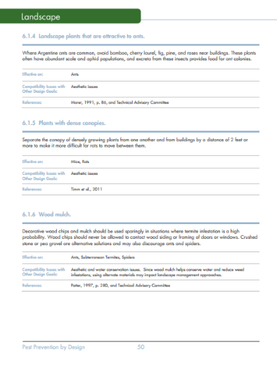
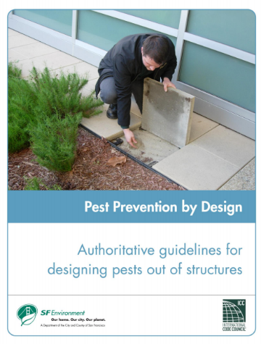
An Ounce of Prevention…
I do IPM!
I do more IPM!
http://www.sfenvironment.org/download/pest-prevention-by-design-guidelines
Google “Pest Prevention By Design”
Harnessing Marketplace Power to Improve Health, Environment and Economics
Notes:
Tom

Slide 21
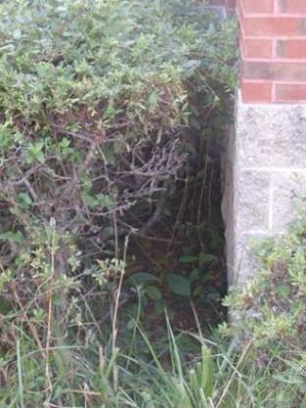
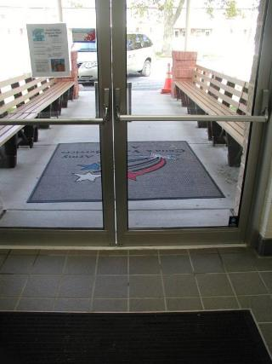
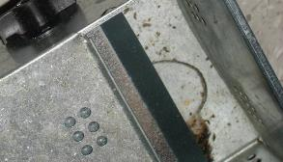
Pennywise…
Notes:
There are many definitions of IPM.
When we arrive, many companies offer customers an IPM-style service.
Our 63-point on-site evaluation is a real eye-opener in terms of what high-level IPM really is.

Slide 22
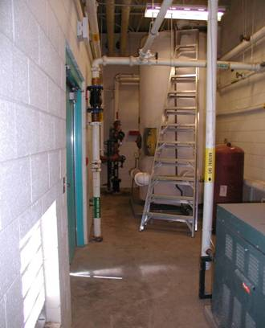
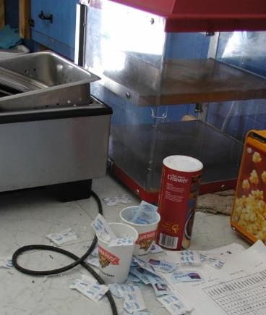
Addressing why Pests are present
Effective door sweeps alone can cut pest complaints by 65%.
Pests, dirt, , staff satisfaction, fire safety, energy conservation, food safety…
Harnessing Marketplace Power to Improve Health, Environment and Economics
Notes:
Tom

Slide 23
How much does each pest complaint cost you?
Harnessing Marketplace Power to Improve Health, Environment and Economics
Notes:
Tom

Slide 24
Stop work, log complaint.
Receive complaint.
Evaluate complaint.
Take action.
Log action, close report.
Harnessing Marketplace Power to Improve Health, Environment and Economics
Notes:
Tom

Slide 25
Wouldn’t you like to cut those costs by 90%?
Harnessing Marketplace Power to Improve Health, Environment and Economics
Notes:
Tom

Slide 26
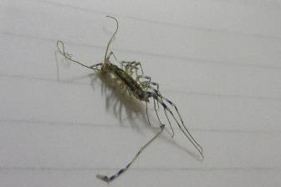
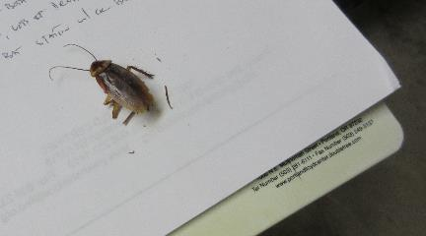
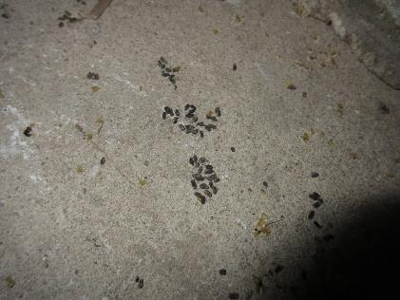
Happy Staff?
Harnessing Marketplace Power to Improve Health, Environment and Economics
Notes:
Tom

Slide 27
Happy Staff?
Harnessing Marketplace Power to Improve Health, Environment and Economics
Notes:
Tom

Slide 28
Business Case?
Fewer staff and student absences
Better student performance
Fewer pests, fewer costly pest complaints
Greater staff satisfaction
Lower liability
Food safety
Fire safety
Energy, water conservation
Better buildings
Direct pest management costs
Indirect costs

Slide 29
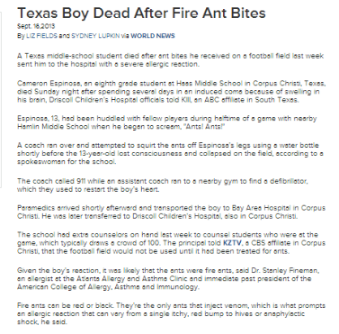
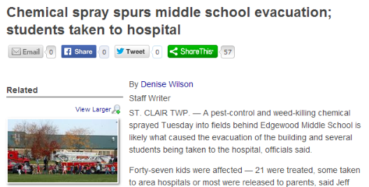
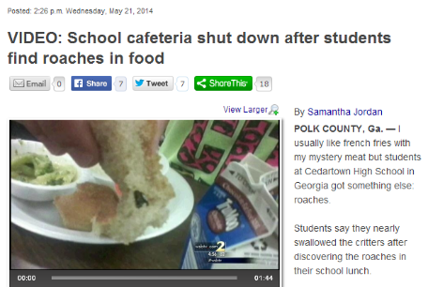
Liability
38% of first 29 IPM STAR-evaluated schools were out of compliance with own policy or legal requirements for applicator qualifications, posting, MSDS/labels, etc.
38% had unmanaged pest problems
Harnessing Marketplace Power to Improve Health, Environment and Economics
Notes:
Tom

Slide 30
Liability
21% of the first 29 IPM STAR-evaluated schools had outdated/unregistered pesticides on the shelf.
Harnessing Marketplace Power to Improve Health, Environment and Economics
Notes:
Tom

Slide 31
Liability
Rodents: transmit Hantavirus, typhus, SARS; trigger asthma attacks.
Birds: carry viruses and other diseases. Airborne droppings can cause histoplasmosis.
Flies: Feed on feces, garbage in one minute, and on food the next. Flies carry staph, E. coli and Salmonella.
Cockroaches: cause asthma and trigger attacks. They carry germs that can cause pneumonia, diarrhea and food poisoning.
Harnessing Marketplace Power to Improve Health, Environment and Economics
Notes:
Tom

Slide 32
Business Case?
Fewer staff and student absences
Better student performance
Fewer pests, fewer costly pest complaints
Greater staff satisfaction
Lower liability
Food safety
Fire safety
Energy, water conservation
Better buildings
Direct pest management costs
Indirect costs

Slide 33
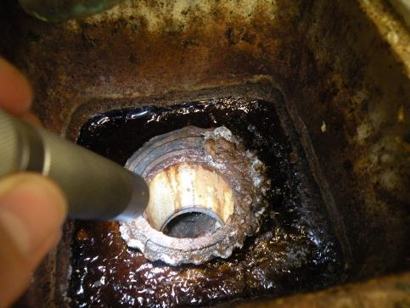
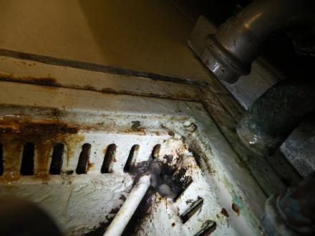
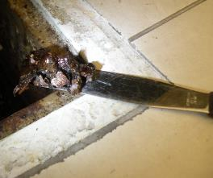
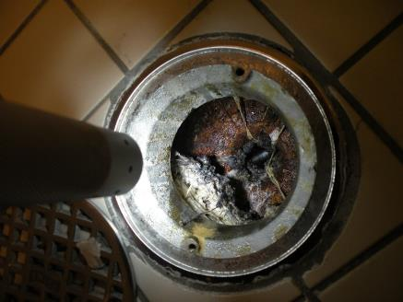
Properly clean and maintain floor drains = Improved fly control and food safety!

Slide 34
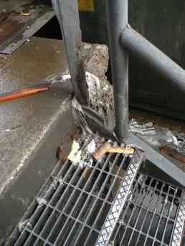
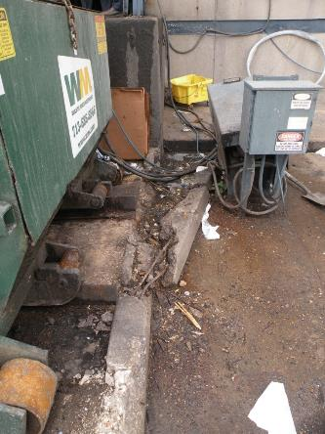
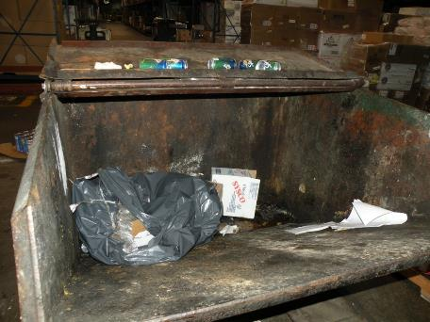
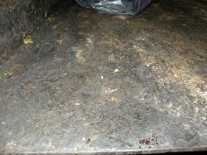
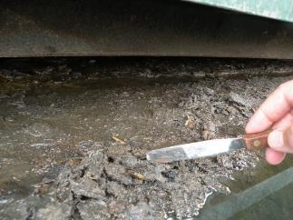
Clean trash handling areas. Decaying organic matter = flies in as little as two days!

Slide 35
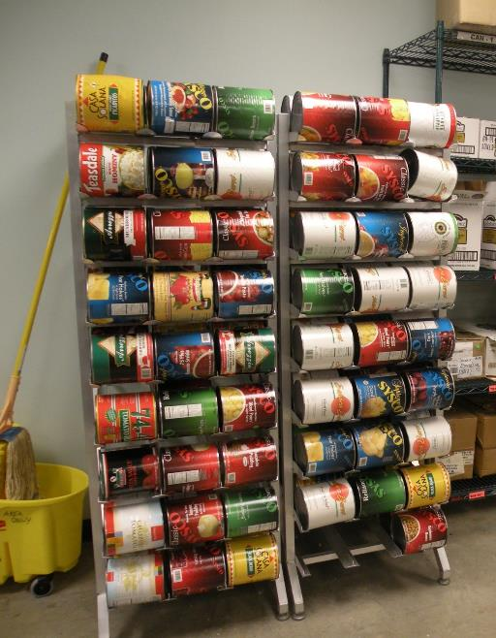

Slide 36
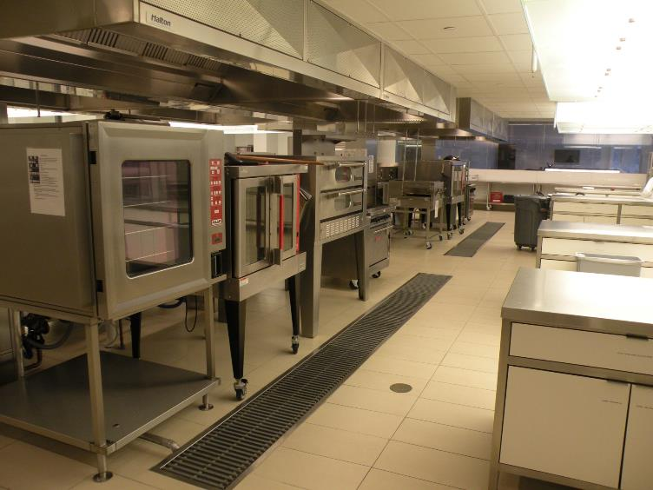
Beautiful commercial kitchen include excellent features including equipment on wheels, and good floor clearance for cleaning and inspection. Floor drains are generally easily accessible and fitted with plastic strainers for easy access.

Slide 37
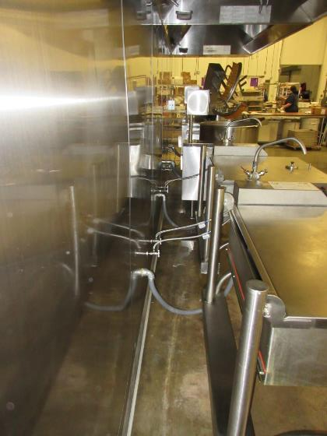
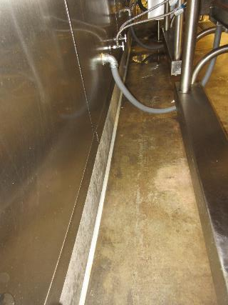
Great access to typically “hard-to-reach” areas for cleaning and inspection.

Slide 38
Business Case?
Fewer staff and student absences
Better student performance
Fewer pests, fewer costly pest complaints
Greater staff satisfaction
Lower liability
Food safety
Fire safety
Energy, water conservation
Better buildings
Direct pest management costs
Indirect costs

Slide 39
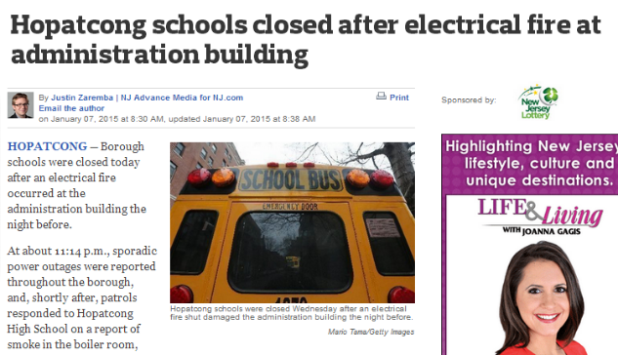
20-25% of electrical fires?

Slide 40
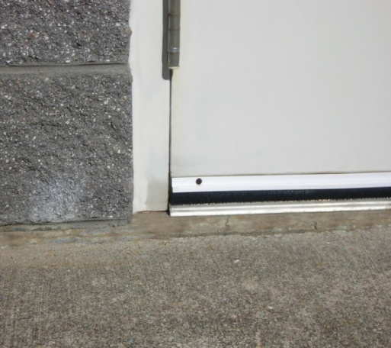
Fire Safety? Energy Conservation?

Slide 41
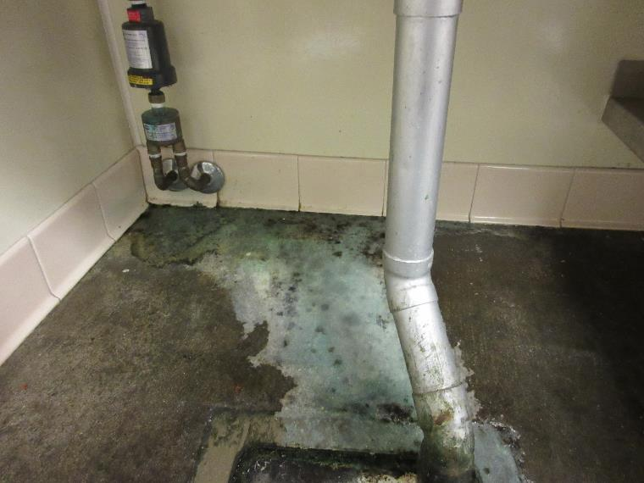
Water Conservation?

Slide 42
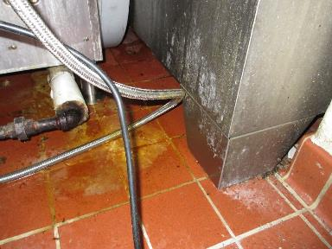
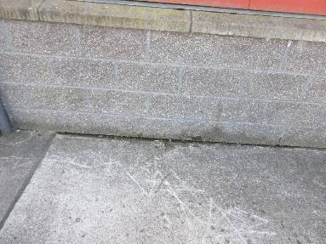
Better Buildings?

Slide 43
Business Case?
Fewer staff and student absences
Better student performance
Fewer pests, fewer costly pest complaints
Greater staff satisfaction
Lower liability
Food safety
Fire safety
Energy, water conservation
Better buildings
Direct pest management costs
Indirect costs

Slide 44
Direct Costs?
Complaint processing
In-house staff salaries
In-house materials costs
Traps
Pesticides: Insecticides, herbicides, adjuvants, fungicides
Contractor costs
Structural, landscape pest management
“Retainer”
Add ons
Repairs? No
Cleaning? No
Aeration, overseeding? No, Maybe
Harnessing Marketplace Power to Improve Health, Environment and Economics
Notes:
Tom

Slide 45
IPM Reduces Pesticide Use!
School systems: 90% reduction in pesticide use; 85% reduction in pest complaints.
Costs: no more than conventional
Gouge et al. 2006. Amer. Entomol.
Public buildings: 93% reduction in pesticide use; 89% reduction in pest complaints; 55 buildings over 11 years.
Greene and Breisch. 2002. J. Econ. Entomol.
Effective door sweeps alone can cut pest complaints by 65%.
Harnessing Marketplace Power to Improve Health, Environment and Economics
Notes:
Tom

Slide 46
To Cut Costs It Takes a Team!
Facility Manager/IPM Coordinator
Maintenance Staff
Administrative Staff
Teacher
Food Service Staff
Custodial Staff
Landscape and Grounds Staff (~55% of districts contract out at least some)
School Nurse
Technician/PMP (~80%)
Harnessing Marketplace Power to Improve Health, Environment and Economics
Notes:
Tom

Slide 47
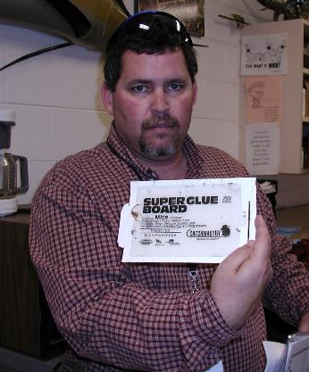
IPM Coordinator
Implements IPM policy.
Maintain IPM plan, i.e., these are the pests we can expect, this is what we do to prevent/respond to problems for each key pest.
Oversees contractors.
Facility manager?
Model plan: schoolipm2015.org
Harnessing Marketplace Power to Improve Health, Environment and Economics
Notes:
Tom

Slide 48
Cost-effective Management
Is PEOPLE management!
Everyone has role to play.
“Do what you’re already doing, just think pests!”
Maintenance, cleaning professionals
School health professionals
Food service professionals
Teachers, administrators, parents, students.
One motivated person can make a HUGE difference. And has! YOU can be a CHAMPION for your school district!
Harnessing Marketplace Power to Improve Health, Environment and Economics
Notes:
Tom

Slide 49
Remember This Guy?
Harnessing Marketplace Power to Improve Health, Environment and Economics
Notes:
Tom

Slide 50
Visit StopSchoolPests.org!
Online IPM training resources in development for nine key groups:
Introduction to IPM (All hands)
Facility Manager
Maintenance Staff
Administrative Staff
Teacher
Food Service Staff
Custodial Staff
Landscape and Grounds Staff
School Nurse
Technician/PMP
Harnessing Marketplace Power to Improve Health, Environment and Economics
Notes:
Tom

Slide 51
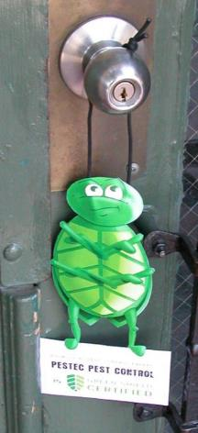
Must haves
Legal compliance
Applicator licensing, state certification
Employee right to know, MSDS/labels
Posting/notification
Safety
Proper PPE, spill kits
Organized, secure, ventilated pesticide storage
Emergency response plan
Professionalism
In business three years
Written protocol, written training plan
IPM
Site inspection, evaluation, testing, recommendations
Least-toxic chemical controls if reasonable non-chemical measures are not adequate (natural and synthetic)
Specific criteria for least toxic, reduced exposure
Scored elements: meet minimum score
Advanced, experimental, variable practices
Not a “must” for a good green service
E.g., offering cleaning, maintenance services.

Slide 52
Common deficiencies corrected…
Regular applications of spray-applied insecticides, typically for cockroaches and/or ants.
Routine maintenance of rodenticides in tamper-resistant bait stations, maybe some tracking powder.
“No pest problems reported/observed” noted on invoice, but pesticide applications made anyway.
No training beyond licensed applicator requirements.
Generally cockroaches, mice, drain flies present, lots of conducive conditions.

Slide 53
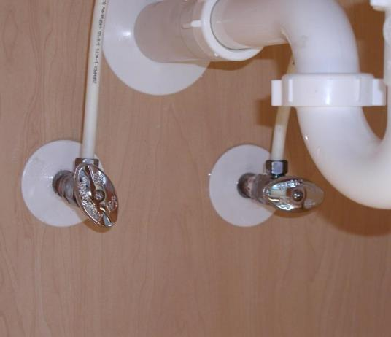
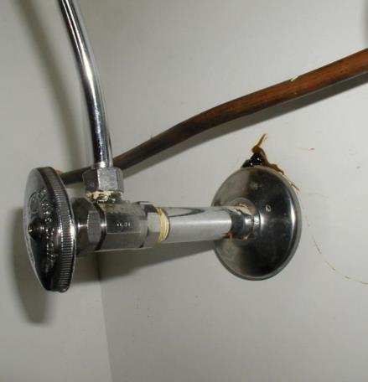
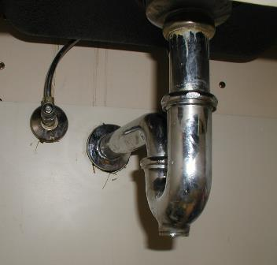
People, training, tools…
How much does it cost our industry to pay technicians to rebait escutcheons?
Seal them once and be done with it!
Harnessing Marketplace Power to Improve Health, Environment and Economics
Notes:
Tom

Slide 54
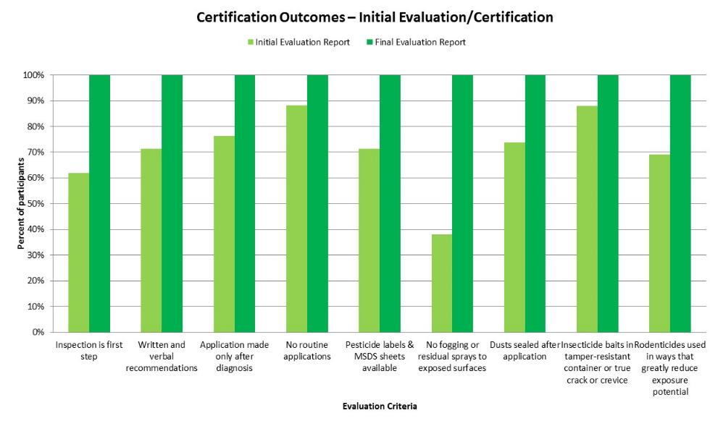
Notes:
This graph gives you an idea of how Green Shield participants improve their performance.

Slide 55
Results!
“Green Shield Certification made us aware of areas in our green approach which required more attention. We became more aware, more enthusiastic, more focused, and more committed to green overall.”
- Lynn Frank, B.C.E. & Technical Director, Suburban Exterminating, Smithtown, NY
“The certification process helped us improve our IPM services and organization, and we are now more efficient and consistent in our approach to providing effective, prevention-based pest control. We're also better able to communicate that approach to our customers.”
- Rita Bonamo, President, Black Widow Termite & Pest Control, Valley Stream, NY

Slide 56
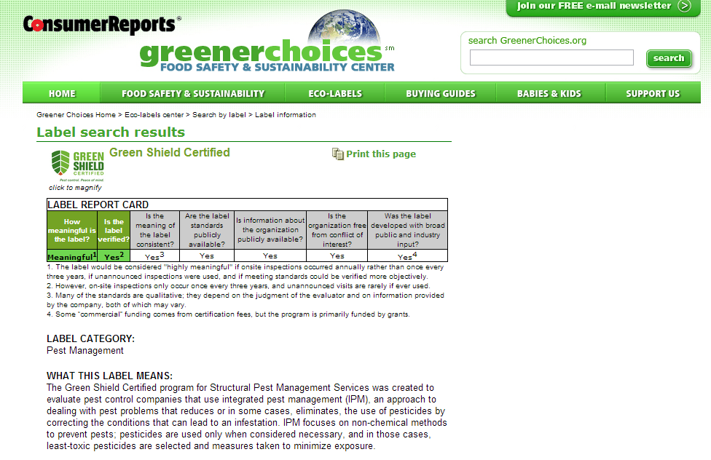
Rated “Meaningful” by CU

Slide 57
Business Case?
Fewer staff and student absences
Better student performance
Fewer pests, fewer costly pest complaints
Greater staff satisfaction
Lower liability
Food safety
Fire safety
Energy, water conservation
Better buildings
Pest management contract costs
Indirect costs

Slide 58
Indirect costs?
What’s a squirrel worth?
Notes:
A recent compilation of studies by the US Geological Survey indicated 96% of fish, 100% of surface water and 33% of major aquifers contain one or more pesticides.
Pesticides were detected in 97% of USGS urban monitoring stations
Levels exceeded benchmarks for protecting aquatic habitat at 87% of these locations – a higher frequency than in agriculture-dominated watersheds
1. http://www.cdc.gov/exposurereport/
2. U.S. Geological Survey, Pesticides in the Nation's Streams and Ground Water, 1992–2001, March 2006.

Slide 59
Indirect costs?
Aquatic organisms?
From 2002-2011, pesticides above levels of concern for aquatics in 90% of URBAN monitoring sites, up from 53% in the prior decade.
Fipronil was the most frequently found, followed by dichlorvos.
Samples above levels of concern for human health way down in second decade. During the first decade, chorpyrifos and diazinon declined, with pyrethroids increasing.
Changes in pesticides found driven by regulation and new products.
Not the whole story: Neonicotinoids, fungicides not included.
Stone, Gilliom and Ryberg. 2014 Pesticides in U.S. Streams and Rivers: Occurrence and Trends during 1992–2011. Environ. Sci. Technol. 48(19):11025–11030.
Notes:
A recent compilation of studies by the US Geological Survey indicated 96% of fish, 100% of surface water and 33% of major aquifers contain one or more pesticides.
Pesticides were detected in 97% of USGS urban monitoring stations
Levels exceeded benchmarks for protecting aquatic habitat at 87% of these locations – a higher frequency than in agriculture-dominated watersheds
1. http://www.cdc.gov/exposurereport/
2. U.S. Geological Survey, Pesticides in the Nation's Streams and Ground Water, 1992–2001, March 2006.

Slide 60
Indirect costs?
Pollinators? ~$29 billion!
Read pesticide labels for new and pre-existing cautions.
Notes:
A recent compilation of studies by the US Geological Survey indicated 96% of fish, 100% of surface water and 33% of major aquifers contain one or more pesticides.
Pesticides were detected in 97% of USGS urban monitoring stations
Levels exceeded benchmarks for protecting aquatic habitat at 87% of these locations – a higher frequency than in agriculture-dominated watersheds
1. http://www.cdc.gov/exposurereport/
2. U.S. Geological Survey, Pesticides in the Nation's Streams and Ground Water, 1992–2001, March 2006.

Slide 61
Progress towards IPM in all of our schools!
AL
CA
FL
GA
KS
LA
NC
NY
MN
ND
OH
OK
SC
SD
IN
TX
WI
AR
HI
LA
MA
MD
MI
MO
OK
RI
SC
SD
VT
WV
WY
CT
NE
OR
MD
ME
NJ
VY
WV
AK
DC
DE
GA
KS
KY
VA
WI
AL
AR
HI
IL
IN
MI
NV
AR
IN
MO
NH
NM
NV
AK
GA
KS
MN
MS
WI
AZ
IA
MA
PA
WA
AL
ID
IN
MS
NV
DE
ID
MO
NH
OK
ND
NM
OR
RI

Slide 62
Closing thoughts…
Think Big!
As in BHAG: Big Hairy Audacious Goals
“Remember, they won’t be
reading your resume at your funeral.”
Rich Kozlovich, Pest Management Inc., Cleveland, OH
Join Us!
Contact: ipmworks@ipminstitute.org
Google: Business Case for IPM in Schools
Harnessing Marketplace Power to Improve Health, Environment and Economics
Notes:
Tom

